Slide 1
AI-Driven Personalized Learning and Remedial Recommendation Through Knowledge Concept-Centric Evaluation
Students
[Student Name 1] · [Roll No.]
[Student Name 2] · [Roll No.]
[Student Name 3] · [Roll No.]
Guide
[Guide Name], [Designation]
Department
[Computer Science and Engineering]
College
[College Name]
Academic Year [2025 – 2026]
Notes:
This final review shows what we built, how each module works with real output, and the results.

Slide 2





PROJECT OVERVIEW
Concept-level learning support, end to end
Our system analyses student responses, identifies weak concepts, generates AI-based remedial recommendations and re-tests the student, in a continuous loop.
Course
Concepts
Questions
Student
Re-test
Recommendation
Weak concepts
Analysis (EKT)
repeat until the target is reached
Final Review · AI-Driven Personalized Learning · 2
Notes:
One sentence summary, then walk the loop once. Everything on this slide was built and is shown working later in the deck.

Slide 3

PROBLEM STATEMENT
Problem, impact and need
PROBLEM
IMPACT
NEED
Marks show how much a student scored, not which concepts they missed. Everyone gets the same material.
Weak concepts stay hidden, mistakes repeat, and teachers cannot personalize for every student.
A system that finds each student's weak concepts and gives targeted help automatically.
Final Review · AI-Driven Personalized Learning · 3
Notes:
Keep this short: the panel heard the full problem at the first review.

Slide 4

LITERATURE REVIEW / RESEARCH GAP
Separate pieces, not one loop
Adaptive assessment
+
Question generation
+
Knowledge tracing
Research gap: these are usually studied separately and rarely linked to Outcome-Based Education targets.
Integrated personalized remedial learning system
Framework of Pradeesh et al. (IEEE Access, 2025), implemented by us with free/offline models, unit-aware retrieval and calibrated mastery
Final Review · AI-Driven Personalized Learning · 5
Notes:
One slide only for the literature. The base paper combines these pieces in one loop; our project implements it and adds three improvements, shown on the comparison slide.

Slide 5




FINAL SYSTEM ARCHITECTURE
The system as implemented
Course PDF
PDF extraction (pypdf)
Unit-aware chunking
MiniLM embeddings
FAISS vector DB
EKT knowledge tracing
Answer storage (OBE records)
Adaptive quiz (web)
MCQ generation + dedup
RAG retrieval
Weak concepts (below 70%)
Remedial generator
Recommendation
Re-test
Progress report
AI layer: Gemini, Groq, OpenRouter or Ollama (free), OpenAI optional, with an offline fallback · dashed: re-test answers are stored and traced again
Final Review · AI-Driven Personalized Learning · 6
Notes:
This is the architecture we actually built, including the parts that differ from the first plan: unit-aware chunking, de-duplication, the web quiz and the free or offline AI layer.

Slide 6








TECHNOLOGY STACK
What the system is built with
Frontend
Backend
AI models
RAG
HTML, CSS, JavaScript
Python, FastAPI, Uvicorn
Gemini, Groq, OpenRouter, Ollama; OpenAI optional
FAISS, MiniLM embeddings, pypdf
Machine learning
Storage
Visualization
Testing
PyTorch: EKT (LSTM), DKT baseline
JSON, CSV and NumPy files
Matplotlib
pytest, 34 tests passing
Final Review · AI-Driven Personalized Learning · 7
Notes:
Only technologies we actually used. There is no database server: data is kept in simple files, which keeps the prototype easy to install.

Slide 7
DATASET / INPUT
A C-programming course and its exam answers
One row per answer
24,000
262
learner_id, question_id,
question_text, concept,
difficulty, bloom_level,
max_marks, marks, order
training answers from 600 students
students in the evaluated batch
Course input: Procedural Programming using C, a curriculum with 5 units and course outcomes CO1–CO5.
2,358
5 · 30
answers, 9 per student
concepts · questions (16 in the exam)
Final Review · AI-Driven Personalized Learning · 8 · Student data is synthetic, from an IRT-based simulator
Notes:
Be clear: no real student records were available, so a simulator based on Item Response Theory generated the answers. The system accepts real exam CSV files with the same columns.

Slide 8
MODULE 1 · COURSE PROCESSING
From a course PDF to five concepts
What the code does
Actual output
Reads the PDF or text with pypdf
Splits it by unit ("Unit 1: …")
Cuts each unit into ~1000-character chunks
Embeds chunks and stores them in FAISS
Asks the AI for one concept per unit
Saves concepts.json for the teacher to check
$ python -m plrs ingest curriculum.txt
Indexed 11 chunks into data/store
Extracted 5 concepts -> concepts.json
C1 CO1 Fundamentals and System Architecture
C2 CO2 Operators, Pointers and Control Structures
C3 CO3 Algorithmic Problem Solving and Arrays
C4 CO4 String Manipulation and Text Processing
C5 CO5 Data Structures, Memory, File Handling
Final Review · AI-Driven Personalized Learning · 9 · Concept names shortened slightly to fit
Notes:
This is the real output of the ingest command on the sample course. Splitting by unit before chunking is our improvement: it keeps each concept's content separate.

Slide 9

MODULE 2 · RAG
The AI writes only from the syllabus
PDF
Chunks
Embeddings
Vector DB
Context
LLM
Retrieved context for "Arrays" (real)
"To find the largest element, assume the first element is the largest and compare it with every other element, updating the assumption when a bigger value is found. Linear search checks each element in turn…"
Retrieved text on the right unit
38% → 100%
fixed chunks vs our unit-aware retrieval
Final Review · AI-Driven Personalized Learning · 10
Notes:
The context shown is real text retrieved from the course's Unit 3. With fixed 1000-character windows only 38% of retrieved sentences were from the right unit; our unit filter makes it 100%.

Slide 10
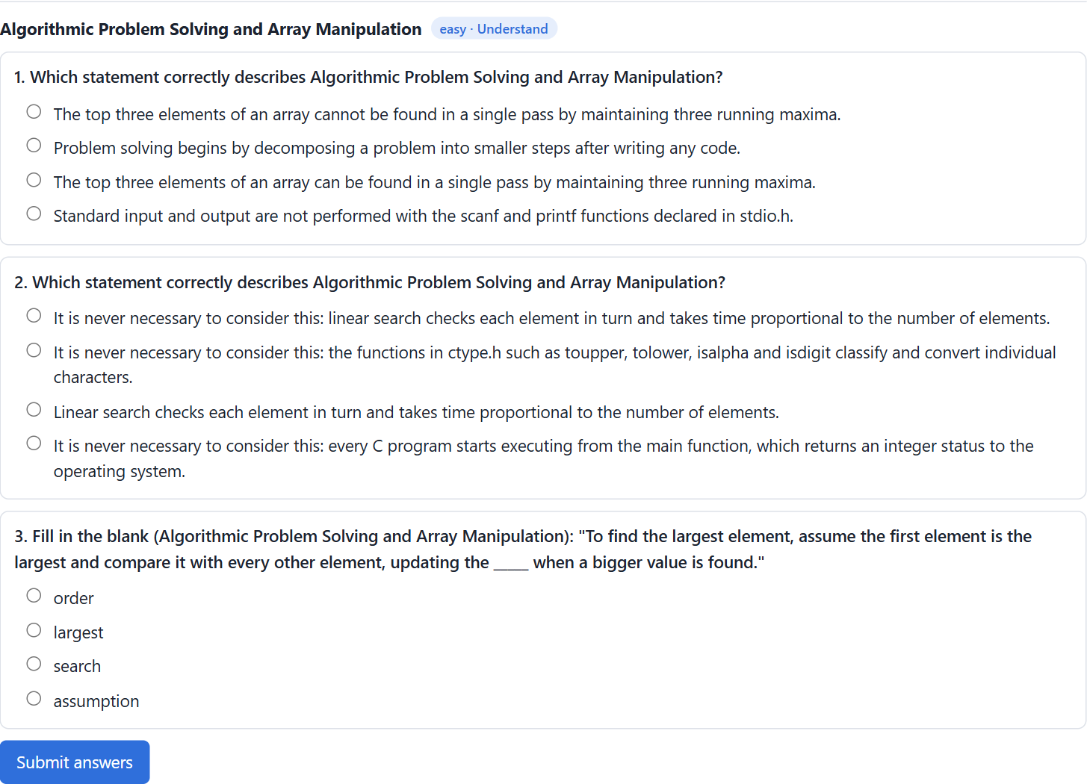
MODULE 3 · MCQ GENERATION
A generated question, as the student sees it
Concept: Algorithmic Problem Solving and Arrays · Difficulty: Easy · Bloom: Remember / Understand
Fill in the blank: "To find the largest element, assume the first element is the largest and compare it with every other element, updating the _____ when a bigger value is found."
A. order · B. largest · C. search · D. assumption (correct)
Explanation: taken from the course material, Unit 3.
90 generated
25 duplicates removed
65 accepted
Final Review · AI-Driven Personalized Learning · 11 · Offline generator; counts from one run
Notes:
Each question has a stem, four options, the correct answer, an explanation, the concept, difficulty and Bloom level. Near-duplicates above 0.85 cosine similarity are removed, and two other models check the rest.

Slide 11
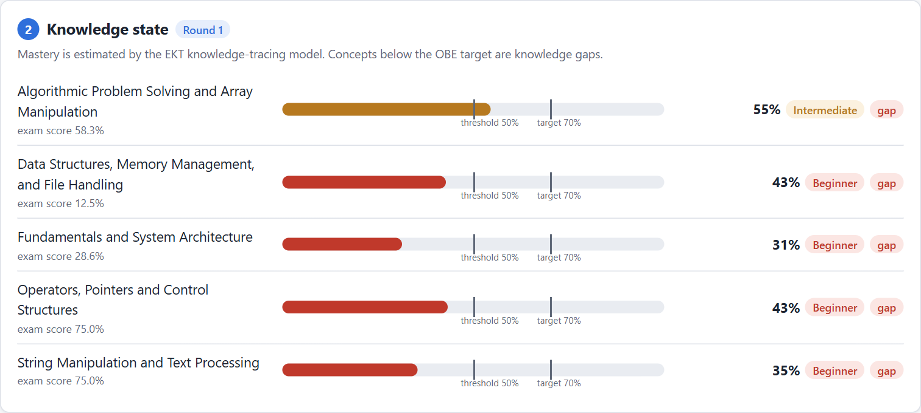
MODULE 4 · KNOWLEDGE TRACING (EKT)
Mastery of each concept for one student
EKT reads each question's text and whether the answer was right, through an LSTM, and outputs mastery per concept.
Target 70%: below it is a weak concept.
Student CSE230001: 55, 43, 31, 43 and 35%, so all five concepts are weak.
Final Review · AI-Driven Personalized Learning · 12 · Real screenshot of the web application
Notes:
This is the real EKT model, not a score-based shortcut: an LSTM over the question text and response, with a mastery output per concept. We also trained DKT as a baseline; results are on the metrics slide.

Slide 12
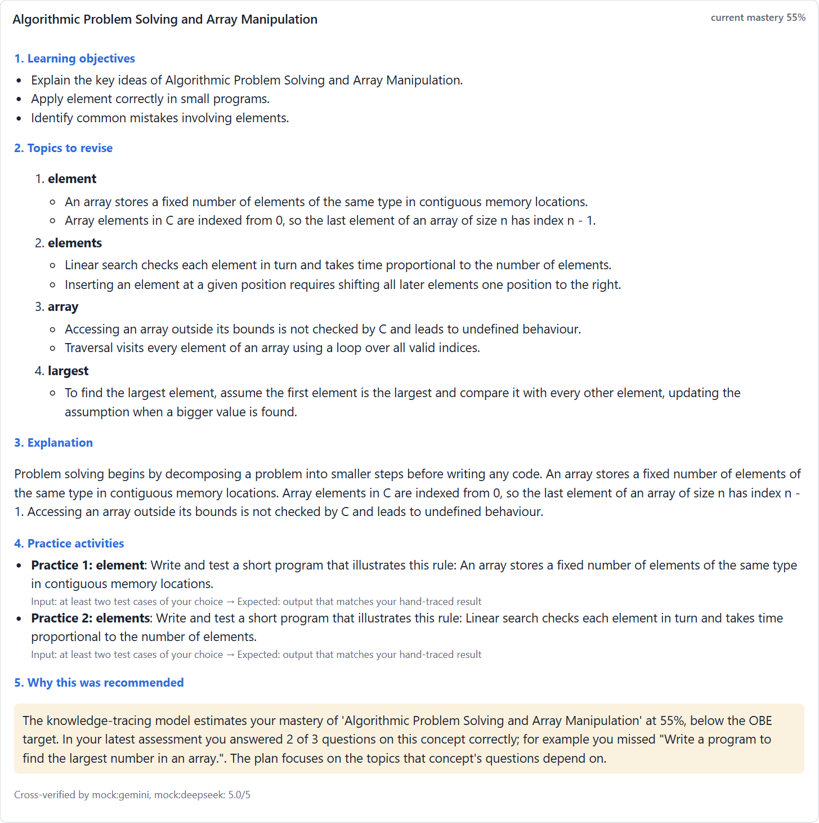
MODULE 5 · REMEDIAL RECOMMENDATION
A five-part plan for the weak concept
WEAK CONCEPT: ARRAYS · MASTERY 55%
1 Learning objectives: explain the key ideas of array problem solving
2 Topics to revise: elements, indexing, array traversal, finding the largest
3 Explanation: rebuilt from the Unit 3 text
4 Practice: write and test a program for each rule
5 Why this plan: "you answered 2 of 3 correctly; you missed Write a program to find the largest number in an array"
Cross-checked by two other AI models before it is shown.
Final Review · AI-Driven Personalized Learning · 13 · Plan text from the real demo run, shortened
Notes:
The five sections follow the base paper. The rationale names the question the student actually missed.

Slide 13

MODULE 6 · RE-TESTING
All five concepts reached the target in one round
Before
Remedial learning
New questions
After
Concept (student CSE230001) | Before | After | Change
Algorithmic problem solving and arrays | 55% | 85% | +30
Data structures, memory and files | 43% | 90% | +47
Fundamentals and system architecture | 31% | 79% | +48
Operators, pointers and control | 43% | 75% | +32
Strings and text processing | 35% | 74% | +39
Final Review · AI-Driven Personalized Learning · 14 · Real demo run; test answers and study effect simulated
Notes:
These are the actual numbers from the demo run. The student's answers in the re-test come from the simulator, so this shows the loop works, not a classroom result.

Slide 14
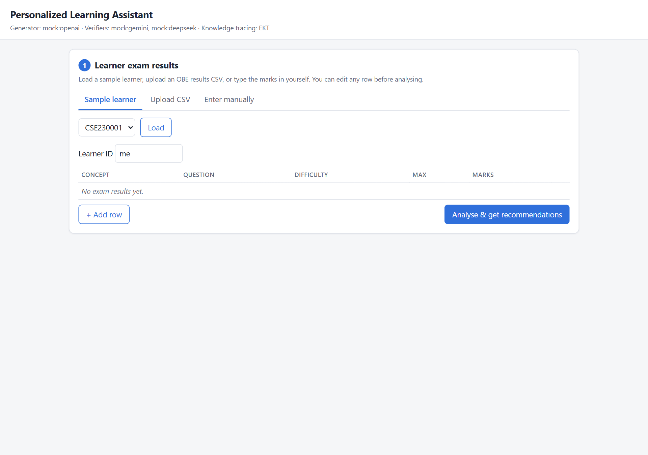
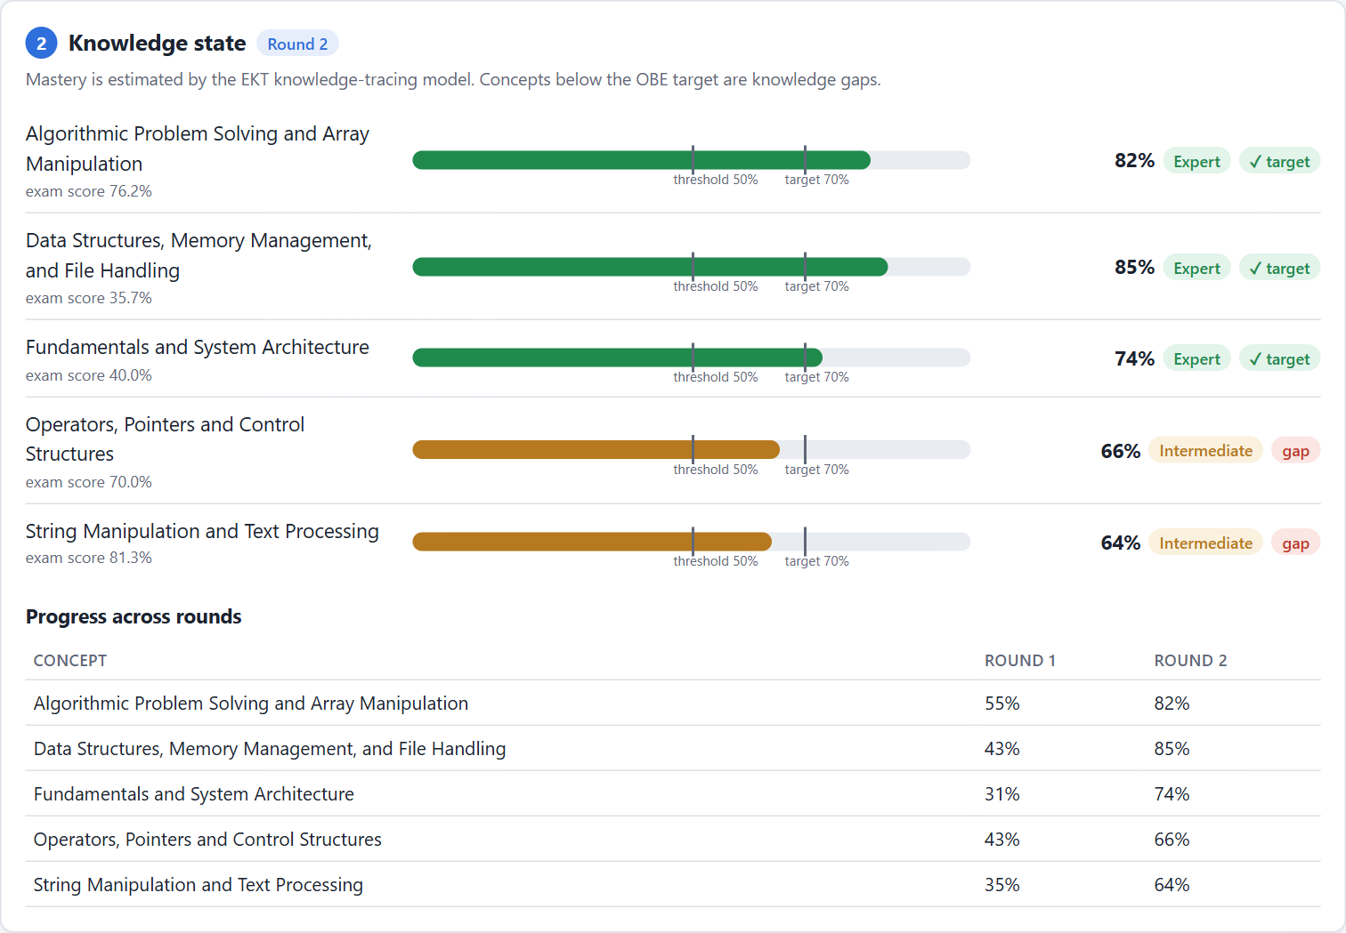
USER INTERFACE
The web application
Start: pick a sample student, upload a CSV or type marks
Round 2: updated mastery and progress across rounds
Final Review · AI-Driven Personalized Learning · 15 · Run with python -m plrs serve, then open http://127.0.0.1:8000/
Notes:
Live demo option: start the server before the review, load student CSE230001, click Analyse, open a plan, take the self-assessment and click Next round. In the round-2 screenshot the answers were entered by a script acting as a student.

Slide 15
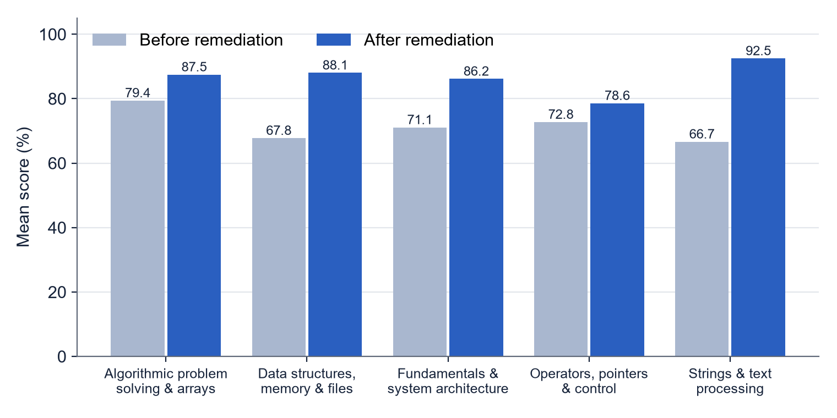
RESULTS · 30 SIMULATED STUDENTS
Scores rose on all five concepts
Concept | Pre | Post | Improvement
Fundamentals | 71.1 | 86.2 | +21.2%
Operators | 72.8 | 78.6 | +8.0%
Arrays | 79.4 | 87.5 | +10.2%
Strings | 66.7 | 92.5 | +38.7%
Data structures | 67.8 | 88.1 | +29.9%
Improvement = (post − pre) ÷ pre × 100. Paired t-test: significant (p < 0.05) for Fundamentals, Strings and Data structures.
Simulated students and learning gain · Final Review · AI-Driven Personalized Learning · 16
Notes:
Scores are mean percentages out of 100. Be clear that the students and the effect of studying are simulated. The paper's own classroom study found significant gains on all five concepts; ours reaches significance on three of five with 30 simulated students.

Slide 16
EVALUATION METRICS
What we measured
Knowledge tracing (test set)
MCQ generation
Metric | EKT (ours) | DKT baseline
Accuracy | 0.748 | 0.630
Precision | 0.787 | 0.654
Recall | 0.779 | 0.778
F1 | 0.783 | 0.710
AUC | 0.827 | 0.665
Duplicate rate 27.8% (25 of 90) · every stored question has 4 options and a valid key
Recommendation loop
38 of 40 simulated students had no gaps after one round, against 27 of 40 without remediation
User satisfaction
Not measured yet; survey questionnaire prepared
Final Review · AI-Driven Personalized Learning · 17 · KT: 12 epochs, 600 simulated students, 75/25 split
Notes:
Only metrics we actually calculated are shown. EKT beats DKT on every knowledge-tracing metric. The loop numbers come from the 40-student simulation in our research paper.

Slide 17
COMPARISON
Traditional, base paper and our system
Feature | Traditional | Base paper | Our system
Concept-level analysis | Limited | Yes | Yes
Personalized recommendation | Generic | Yes, five parts | Yes, five parts, cross-checked
AI question generation | No | Yes | Yes, de-duplicated
Knowledge tracking | Limited | EKT | EKT with calibrated mastery
Re-testing | Limited | Yes | Adaptive, fresh questions
Retrieval stays on topic | – | Fixed chunks | Unit-aware, 100% on-topic
Runs without paid AI | – | Commercial APIs | Free tiers or offline
Web app, API and tests | – | In-house LMS | Yes, 34 tests
Final Review · AI-Driven Personalized Learning · 18
Notes:
The base paper integrated the loop inside its own LMS with commercial AI models. We kept its design and added unit-aware retrieval, calibrated mastery, free or offline AI, and a tested open web application.

Slide 18
LIMITATIONS AND FUTURE SCOPE
What remains to be done
Limitations
Future scope
Synthetic students, not a real class
Real AI output quality not yet measured (free-tier limits)
Generated content needs teacher checking
EKT needs enough answers per concept
Course PDF quality affects results
Pilot with a real class and real pre/post tests
Teacher analytics dashboard
Feedback on each wrong answer the student chose
Integration with an LMS such as Moodle
Multilingual support and a mobile app
Final Review · AI-Driven Personalized Learning · 19
Notes:
Be honest about the synthetic data. The mistake-level feedback addresses the lowest-rated item in the base paper's own student survey.

Slide 19
CONCLUSION
From marks to mastery, automatically
Our system finds each student's weak concepts, generates targeted remedial plans and new questions from the syllabus, and re-tests the student in a continuous loop. It works with free or offline AI models and outperforms the DKT baseline in knowledge tracing.
Thank you · Questions?
Final Review · AI-Driven Personalized Learning · 20
Notes:
Summarise in one breath and open for questions. Keep the live demo ready if the panel asks.

